Slide 1

Master Thesis on Intelligent Interactive Systems Universitat Pompeu Fabra The Price Impact of Sustainability on Housing Prices in Barcelona A Multidimensional Data-Driven Approach
Examples of Demonstrative Maps
Author: Niels Box
Supervisor: Manuel Portela
Notes:
60 Seconds

Slide 2
Introduction
Five demonstrative maps are shown to display the workings of the code and the offered flexibility.
Firstly, the purpose of the demonstrative maps and the parameters are discussed
Secondly, screenshots of the demonstrative map are shown. The screenshots include a variety of the screenshots from a high zoom level, low zoom level and shown cluster/property specific information. Therefore, it is recommended to view all the examples.
Notes:
110 sec

Slide 3
Example 1: Purpose and parameters
The purpose of example 1 is to display information about the price impact of all sustainable variables in Model 7 on the housing prices in the subdistrict Nou-Barris.
Parameters | Example Map 1
Selected Sustainable Features | Sustainable_predictors
Map_save_name | ‘slideshow_map_1'
Title | 'Total Price Impact Sustainability Variables Model 7 on Residential Properties in the District Nou-Barris’
Subtitle | "Heckman Selection Model Barcelona"
Legend_title | 'Quantile Total Price Impact Sustainable Variables'
Circle_Multiplier | 15
DF | df_ols
Model_result | SL_ols_model_7_result
Color_var | "Sustainable Features Price Impact"
N_color_cat | 10
Model_predictors | Model_7_predictors_order
Filter_dic | Filter_dic[‘filter_sign’] = ‘equal to’ Filter_dic[‘filter variable’] = ‘District’ Filter_dic[filter_value’] = ‘District Nou Barris”
Variable_type_dic | Variable_type_predictors (specified in the notebook)
Ref_group_dic | Ref_group_dic (specified in the notebook)
N_clusters | N/A
Lat_col | ‘latitude’
Long_col | ‘longitude’
Show_all (True/False) | True
SVM_Cluster (True/False) | False
Subdistrict_Cluster (True/False) | False
Save (True/False) | True
Notes:
110 sec

Slide 4
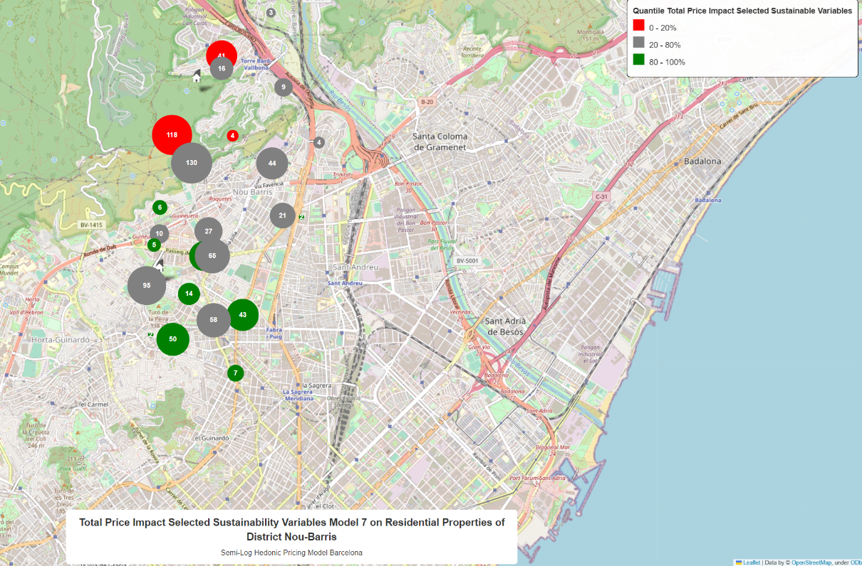
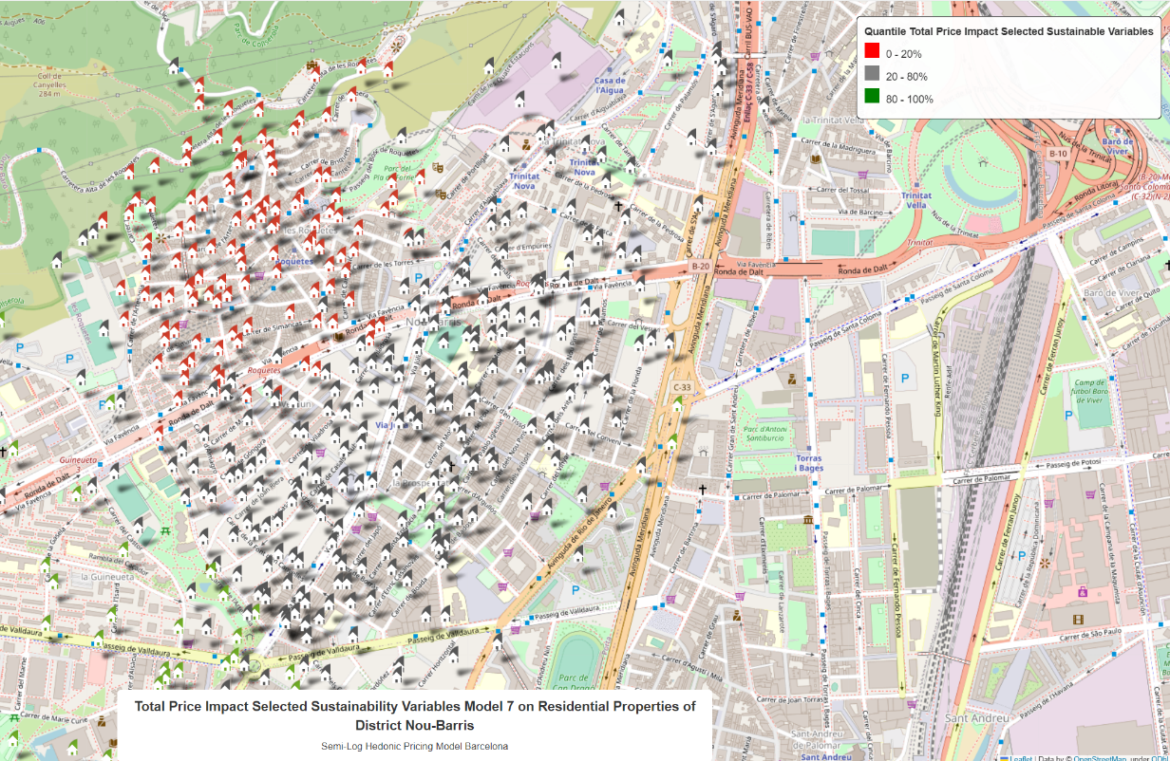
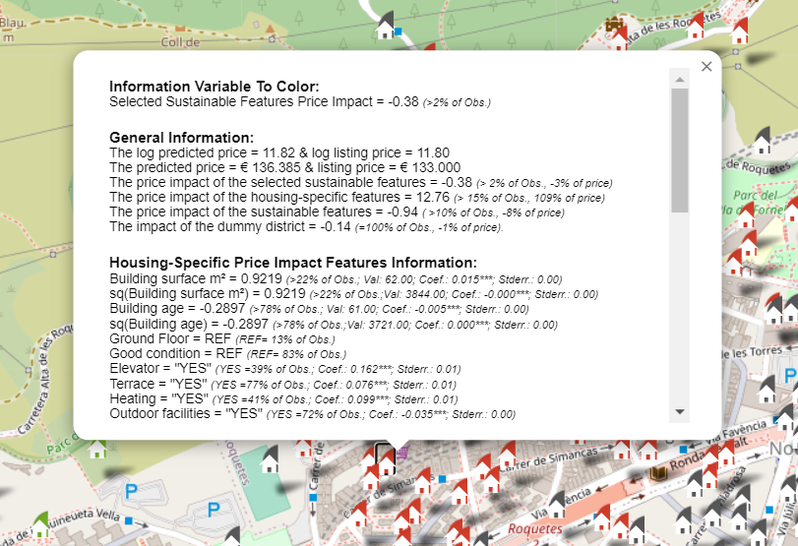
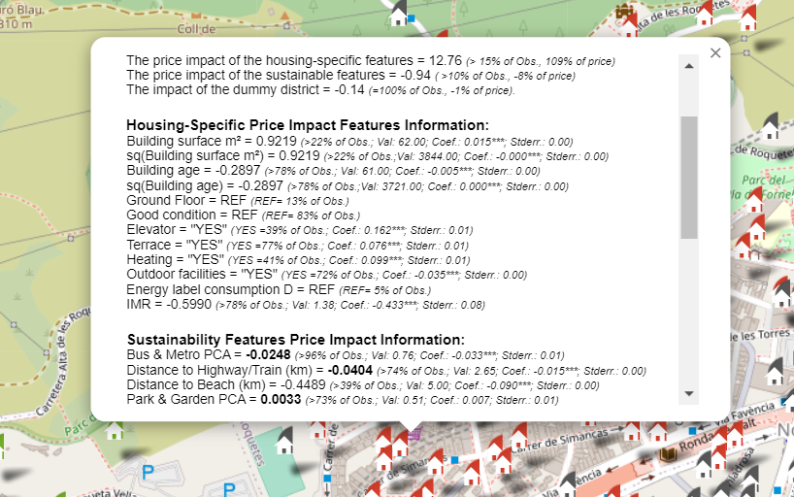
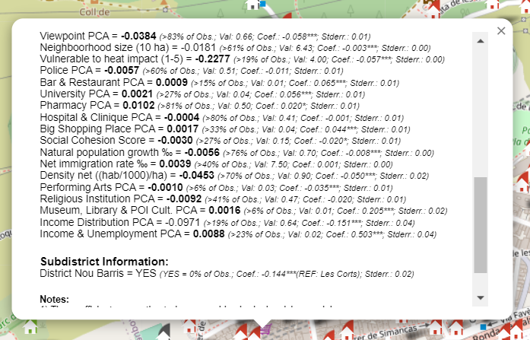
Example 1: Screenshots
Notes:
110 sec

Slide 5
Example 2: Purpose and parameters
The purpose of example 2 is to display information about the price impact of all sustainable variables in Model 7 on the housing prices in the subdistrict Nou-Barris in 100 clusters.
Parameters | Example Map 2
Selected Sustainable Features | Sustainable_predictors
Map_save_name | ‘slideshow_map_2'
Title | 'Total Price Impact Sustainability Variables Model 7 on Residential Properties in the District Nou-Barris by 100 clusters’
Subtitle | "Heckman Selection Model Barcelona"
Legend_title | 'Quantile Total Price Impact Sustainable Variables'
Circle_Multiplier | 15
DF | df_ols
Model_result | SL_ols_model_7_result
Color_var | "Sustainable Features Price Impact"
N_color_cat | 5
Model_predictors | Model_7_predictors_order
Filter_dic | Filter_dic[‘filter_sign’] = ‘equal to’ Filter_dic[‘filter variable’] = ‘District’ Filter_dic[filter_value’] = ‘District Nou Barris”
Variable_type_dic | Variable_type_predictors (specified in the notebook)
Ref_group_dic | Ref_group_dic (specified in the notebook)
N_clusters | 100
Lat_col | ‘latitude’
Long_col | ‘longitude’
Show_all (True/False) | True
SVM_Cluster (True/False) | True
Subdistrict_Cluster (True/False) | False
Save (True/False) | True
Notes:
110 sec

Slide 6
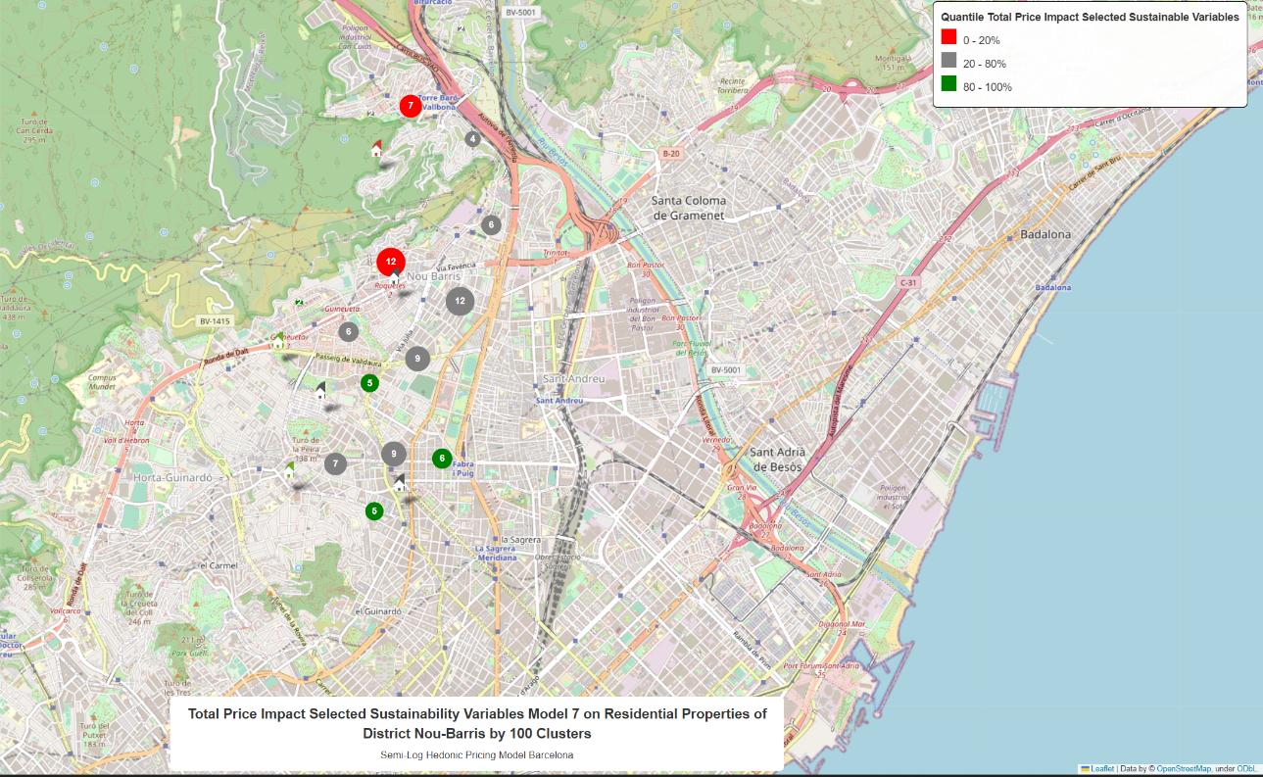
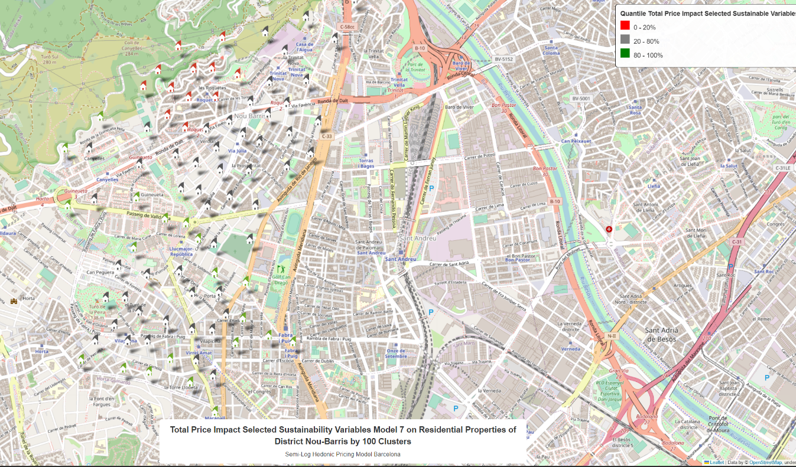
Example 2: Screenshots
Note: Less observations are shown in example 2 compared to example 1 by clustering with the support vector machine
Notes:
110 sec

Slide 7
Example 3: Purpose and parameters
The purpose of example 3 is to display information about the price impact of all sustainable variables in Model 7 on the housing prices lower than € 1.000.000 by the subdistrict.
Parameters | Example Map 3
Selected Sustainable Features | Sustainable_predictors
Map_save_name | ‘slideshow_map_3'
Title | 'Total Price Impact Selected Sustainability Variables Model 7 on Residential Properties a housing price lower than € 1.000.000 by the subdisticts'
Subtitle | "Heckman Selection Model Barcelona"
Legend_title | 'Quantile Total Price Impact Sustainable Variables'
Circle_Multiplier | 15
DF | df_ols
Model_result | SL_ols_model_7_result
Color_var | "Sustainable Features Price Impact"
N_color_cat | 5
Model_predictors | Model_7_predictors_order
Filter_dic | Filter_dic[‘filter_sign’] = ‘lower’ Filter_dic[‘filter variable’] = ‘Price’ Filter_dic[filter_value’] = 1000
Variable_type_dic | Variable_type_predictors (specified in the notebook)
Ref_group_dic | Ref_group_dic (specified in the notebook)
N_clusters | 100
Lat_col | ‘latitude’
Long_col | ‘longitude’
Show_all (True/False) | True
SVM_Cluster (True/False) | True
Subdistrict_Cluster (True/False) | False
Save (True/False) | True
Notes:
110 sec

Slide 8
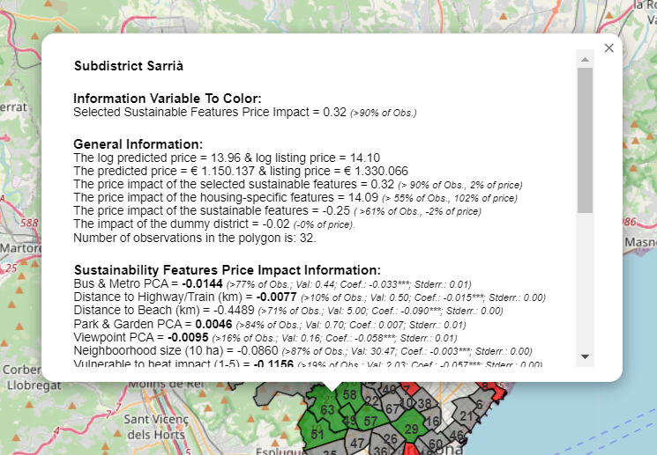
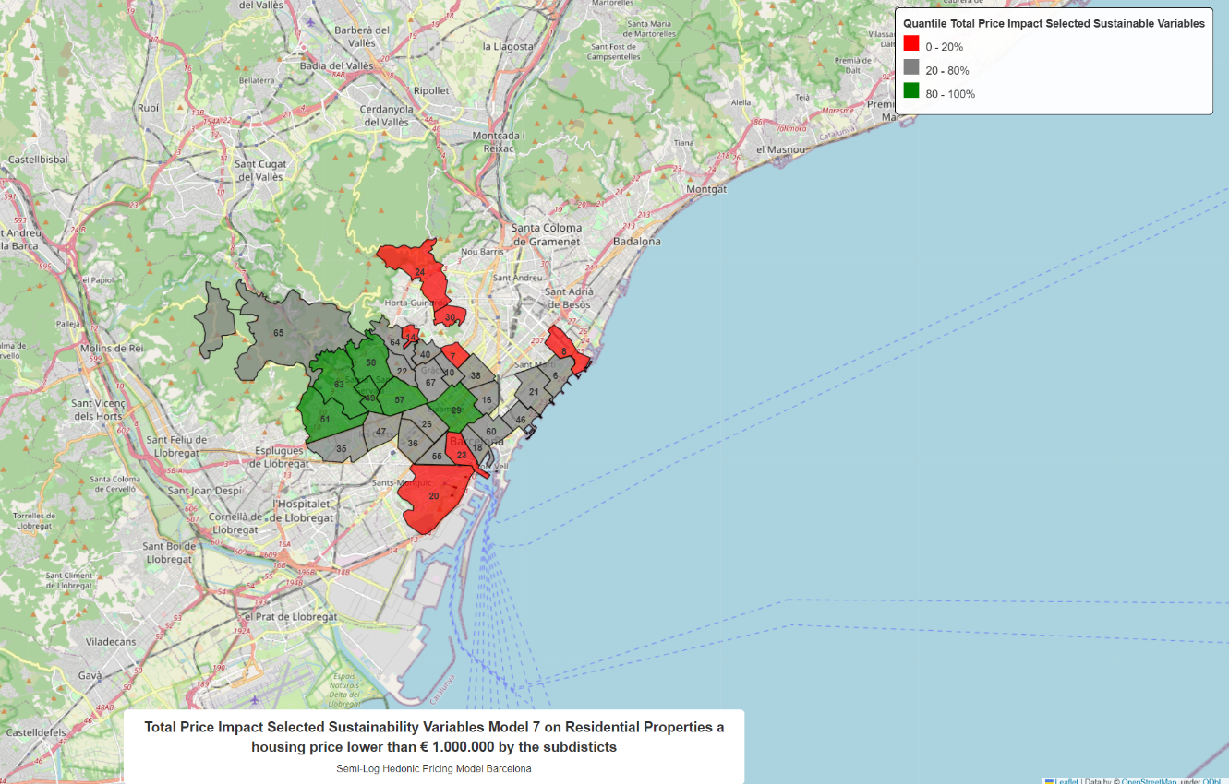
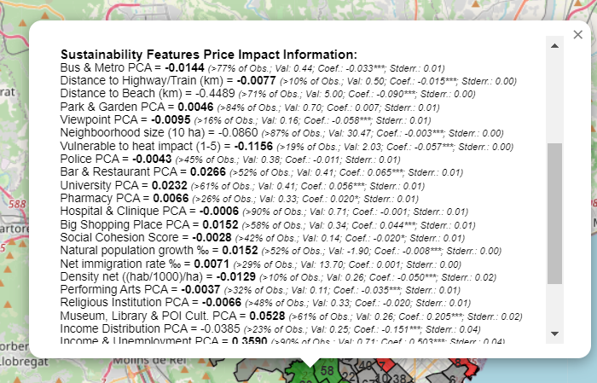
Example 3: Screenshots
Notes:
110 sec

Slide 9
Example 4: Purpose and parameters
The purpose of example 3 is to display information about the price impact of the environmental variables in Model 2 on the housing prices by the subdistrict showing only the highest and lowest category.
Parameters | Example Map 4
Selected Sustainable Features | ['Bus & Metro PCA', 'Distance to Highway/Train (km)']
Map_save_name | ‘slideshow_map_4'
Title | Total Price Impact Environmental Dimension of Sustainability in Model 2 on Residential Properties clustered by the subdisticts displaying only the highest and lowest category'
Subtitle | "Heckman Selection Model Barcelona"
Legend_title | 'Quantile Total Price Impact Sustainable Variables'
Circle_Multiplier | 15
DF | df_ols
Model_result | SL_ols_model_2_result
Color_var | "Sustainable Features Price Impact"
N_color_cat | 10
Model_predictors | Model_2_predictors_order
Filter_dic | Filter_dic = {}
Variable_type_dic | Variable_type_predictors (specified in the notebook)
Ref_group_dic | Ref_group_dic (specified in the notebook)
N_clusters | 100
Lat_col | ‘latitude’
Long_col | ‘longitude’
Show_all (True/False) | True
SVM_Cluster (True/False) | True
Subdistrict_Cluster (True/False) | False
Save (True/False) | True
Notes:
110 sec

Slide 10
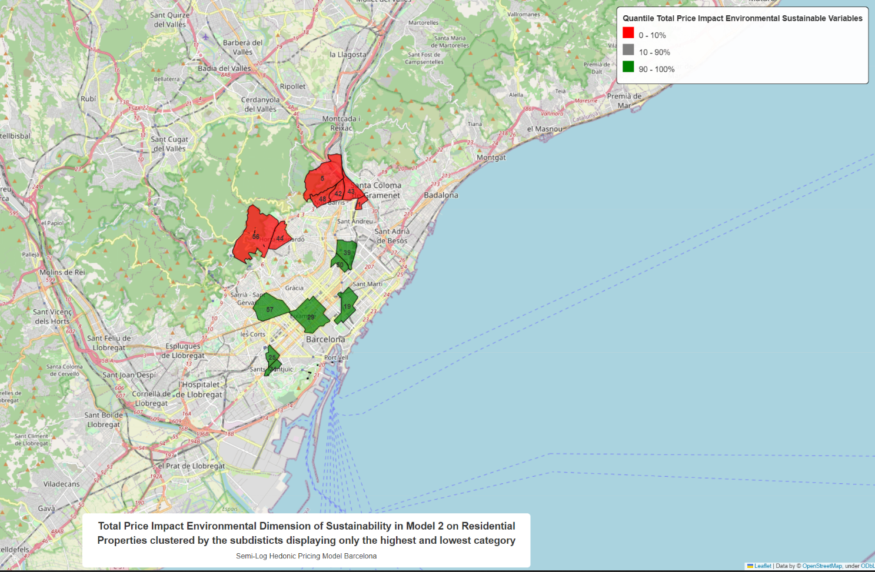
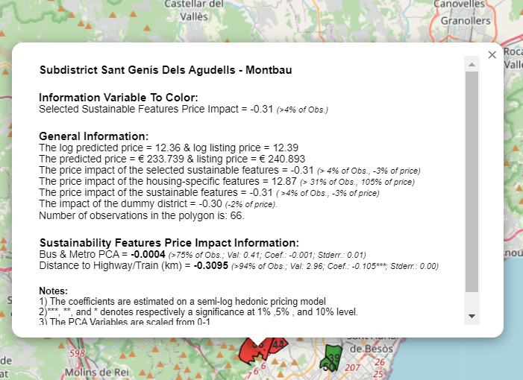
Example 4: Screenshots
Notes:
110 sec

Slide 11
Example 5: Purpose and parameters
The purpose of example 3 is to display information about the price impact of the environmental variables in Model 2 on the housing prices by the subdistrict showing only the highest and lowest category in 100 categories.
Parameters | Example Map 5
Selected Sustainable Features | ['Bus & Metro PCA', 'Distance to Highway/Train (km)']
Map_save_name | ‘slideshow_map_7'
Title | 'Total Price Impact Sustainability Variables Model 7 on Residential Properties without outdoor facilities displaying and the highest and lowest category.
Subtitle | "Heckman Selection Model Barcelona"
Legend_title | 'Quantile Total Price Impact Sustainable Variables'
Circle_Multiplier | 15
DF | df_ols
Model_result | SL_ols_model_7_result
Color_var | "Sustainable Features Price Impact"
N_color_cat | 10
Model_predictors | Model_7_predictors_order
Filter_dic | Filter_dic[‘filter sign’] = ‘not equal to’ Filter_dic[‘filter variable’] ‘Outdoor facilities’ Filter_dic[‘filter value’] = 1
Variable_type_dic | Variable_type_predictors (specified in the notebook)
Ref_group_dic | Ref_group_dic (specified in the notebook)
N_clusters | N/A
Lat_col | ‘latitude’
Long_col | ‘longitude’
Show_all (True/False) | True
SVM_Cluster (True/False) | False
Subdistrict_Cluster (True/False) | False
Save (True/False) | True
Notes:
110 sec

Slide 12
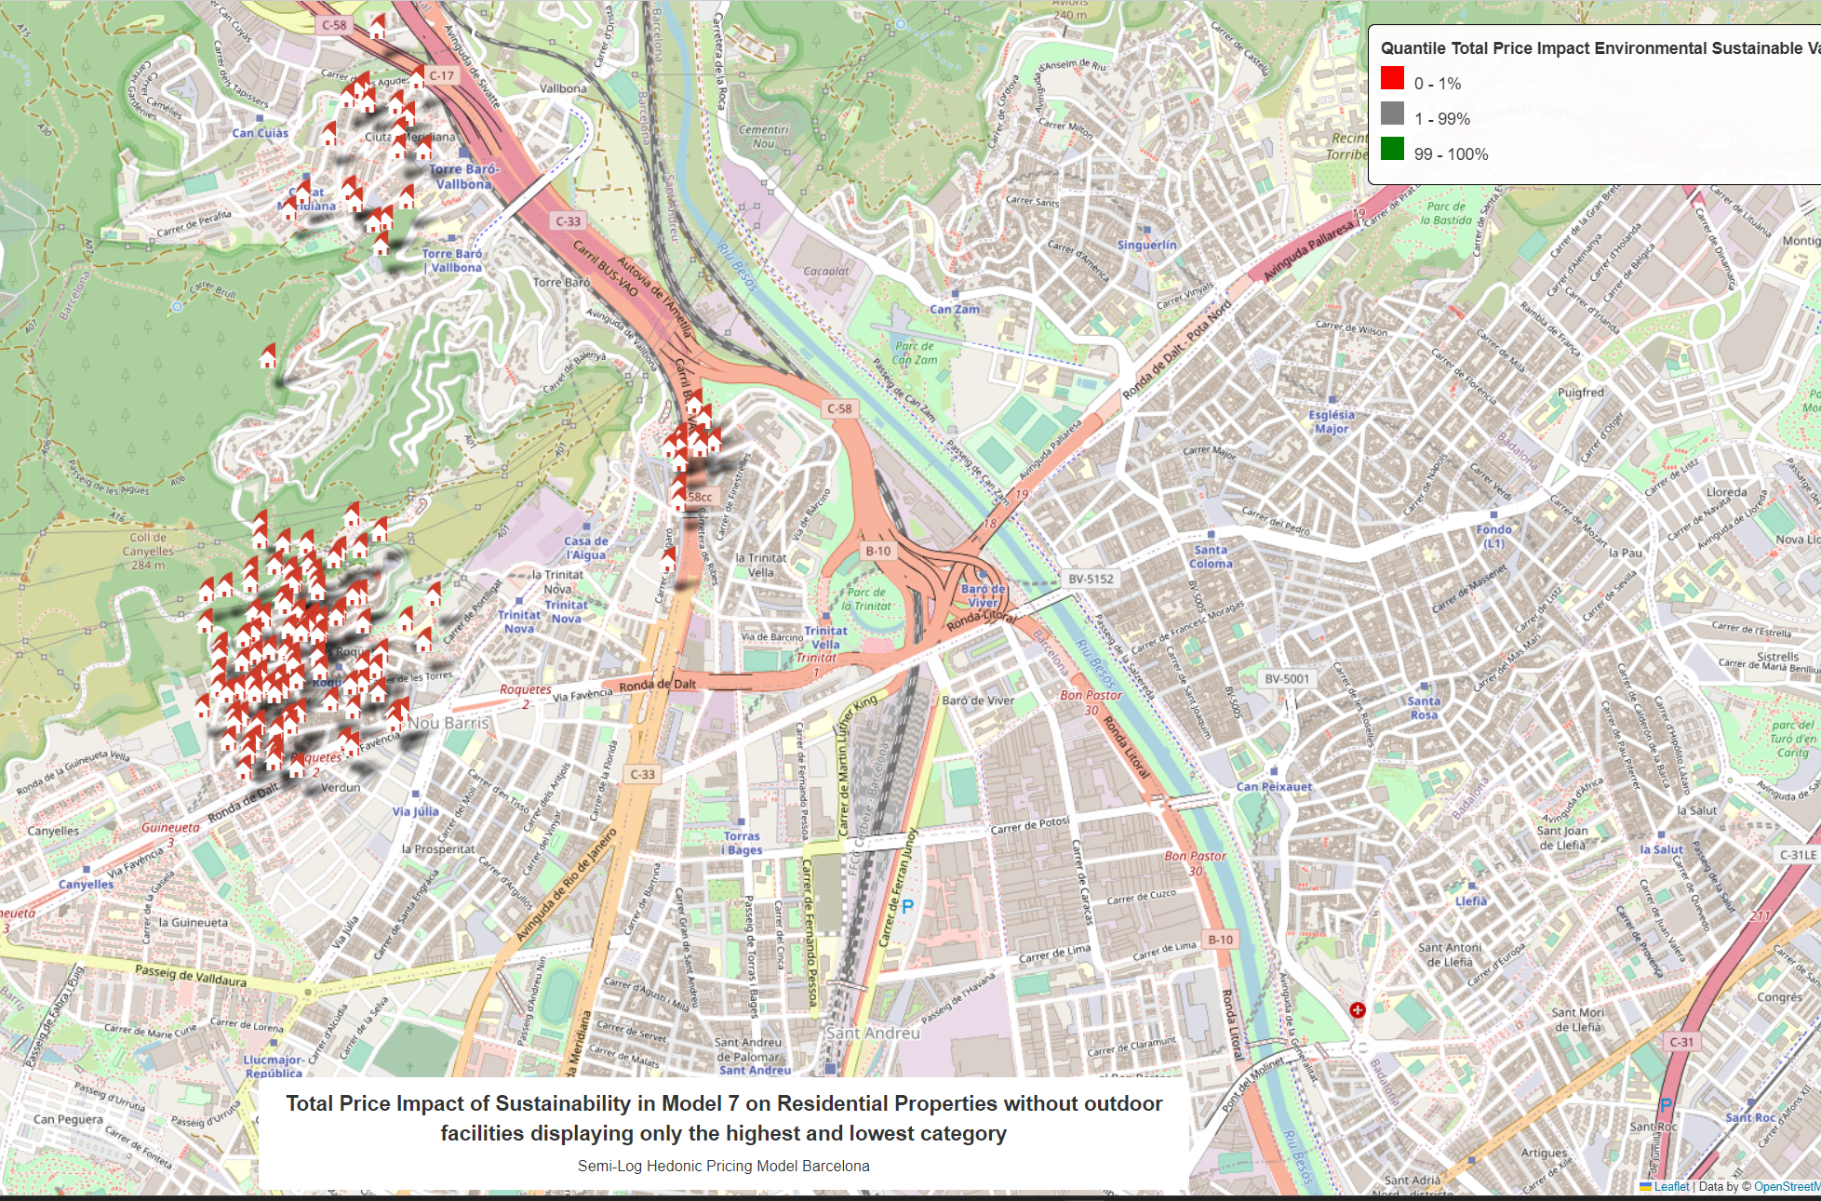
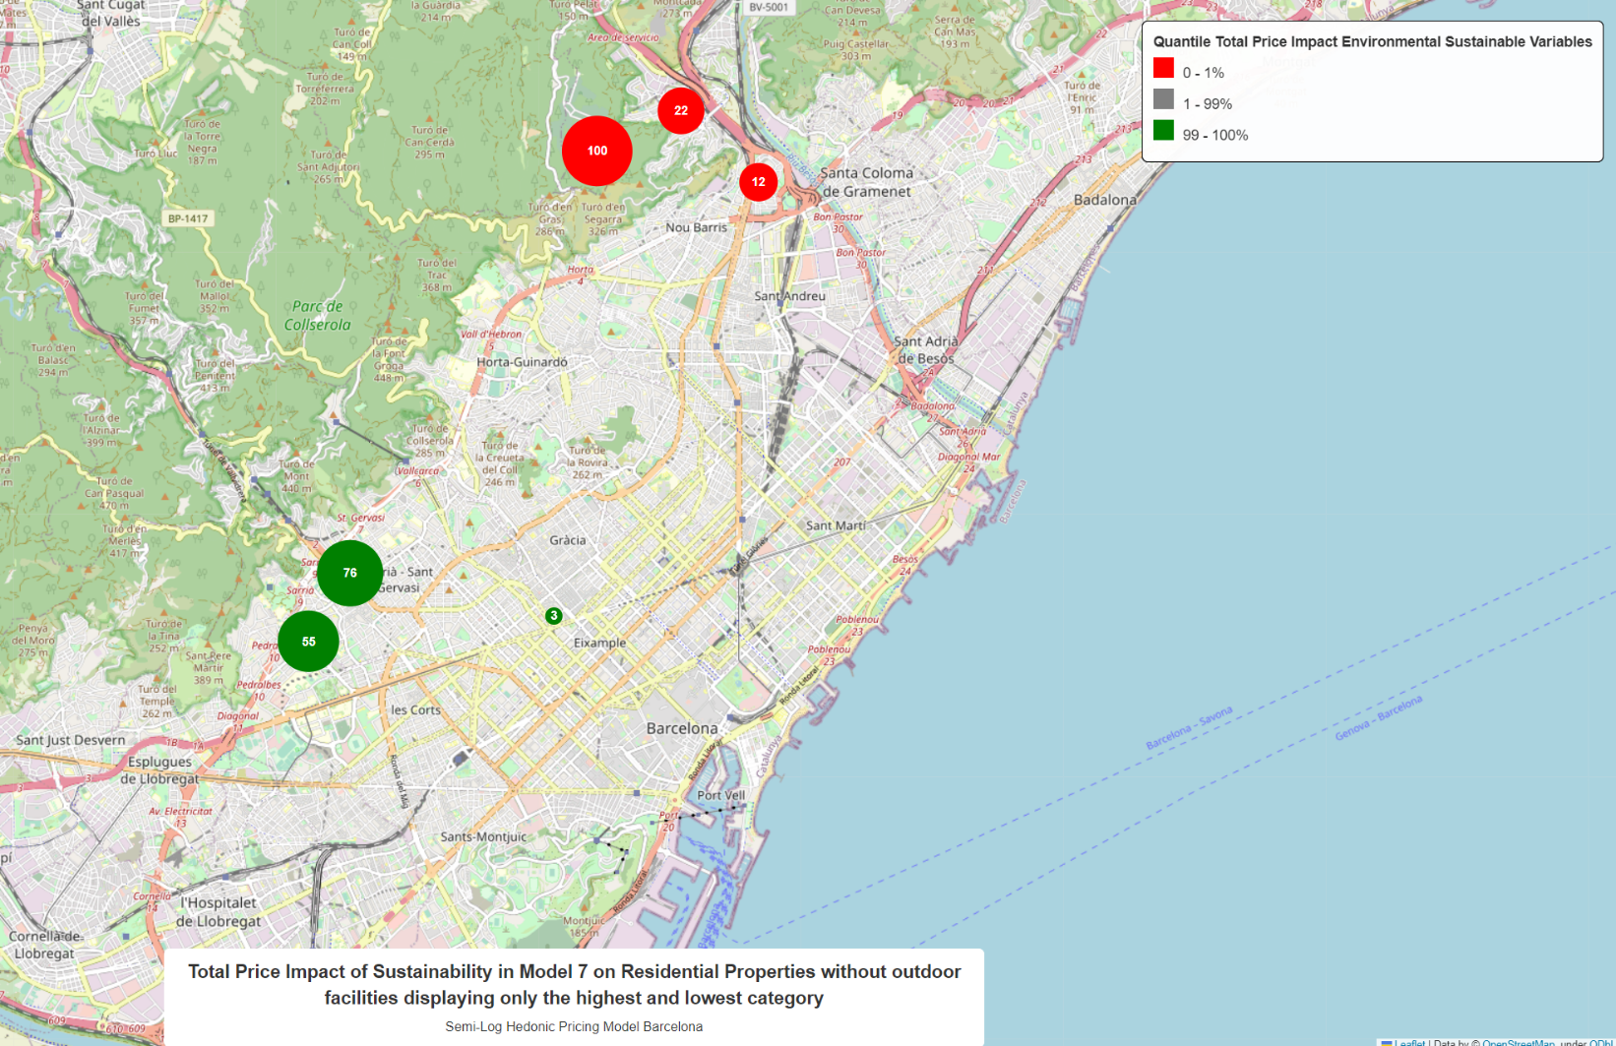
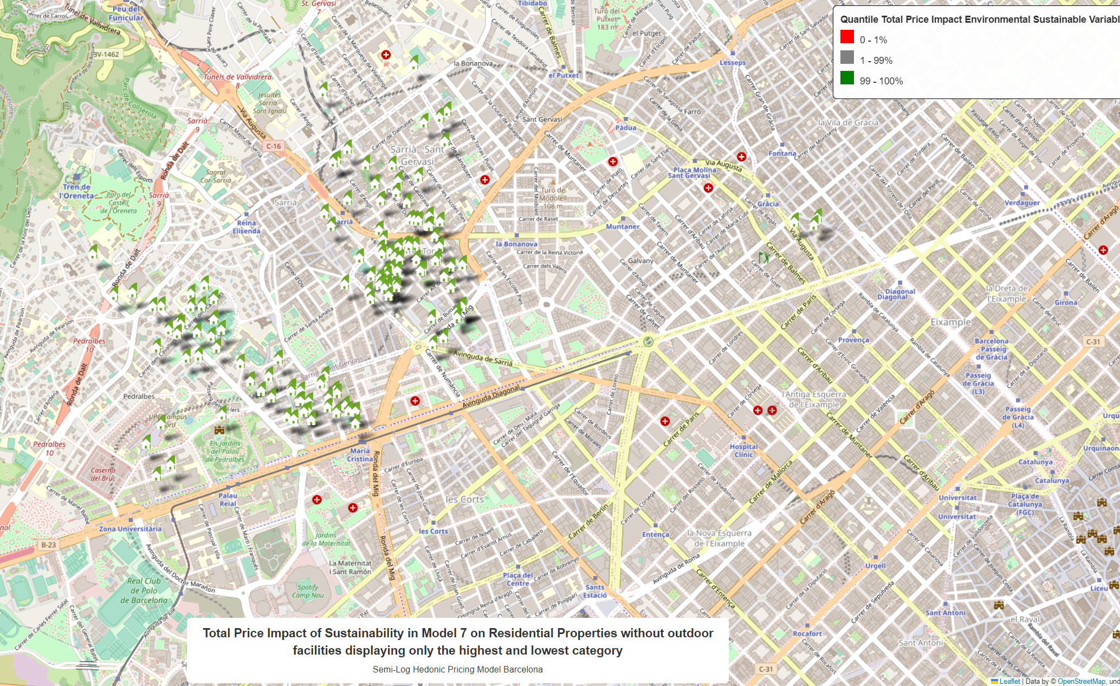
Example 5: Screenshots
Notes:
110 sec

